Slide 1
INTRODUCTION

Slide 2
Who I Am
A Creative Technologist who has worked in Advertising for over 10 years doing creative executions for companies such as Verizon, Motorola, Prudential, Under Amour, Belvita, Chobani. I have won numerous awards in both the creative and advertising fields. I currently co-own a creative agency.
Basically a design geek and nerd.

Slide 3
Who Are You?

Slide 4
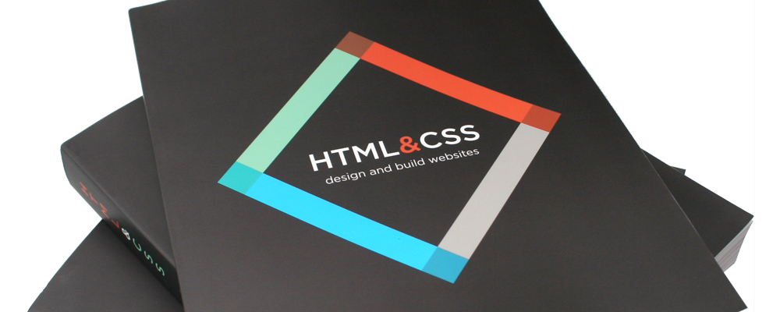
Books For This Class
Books For This Studio
HTML & CSS | Design and Build Websites Javascript & Jquery |Interactive Frontend Development

Slide 5
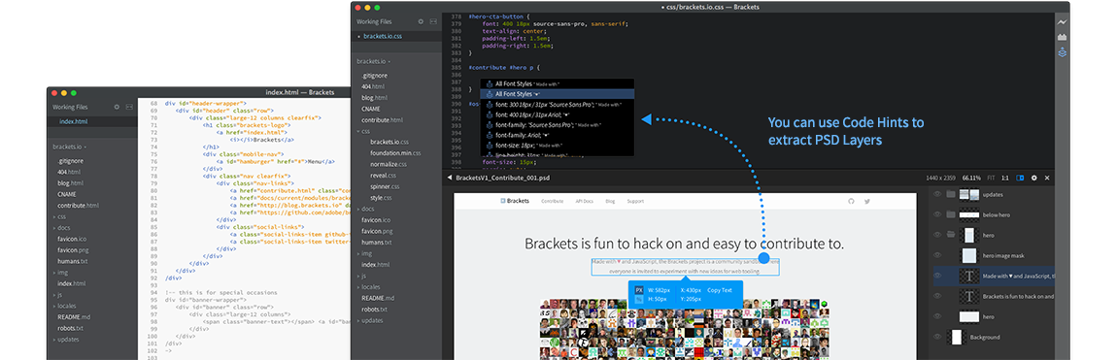
Tools For This Studio
Brackets.io – easy to use code editor from adobe. [And Free!] Alternatives Sublime Text 3 Code 2 Text Mate Notepad ++

Slide 6
Main Assignments
Project 1 – Creating a simple landing page for an application.
Project 2 – Creating a digital magazine

Slide 7
Homework and Readings
Homework and readings will be assigned at the end of class. They are meant to be simple and fun and will be posted to the class site.

Slide 8
How you will be graded
You will be graded based on your ability to complete the class assignments, with both an eye towards aesthetic and code quality / completeness.

Slide 9
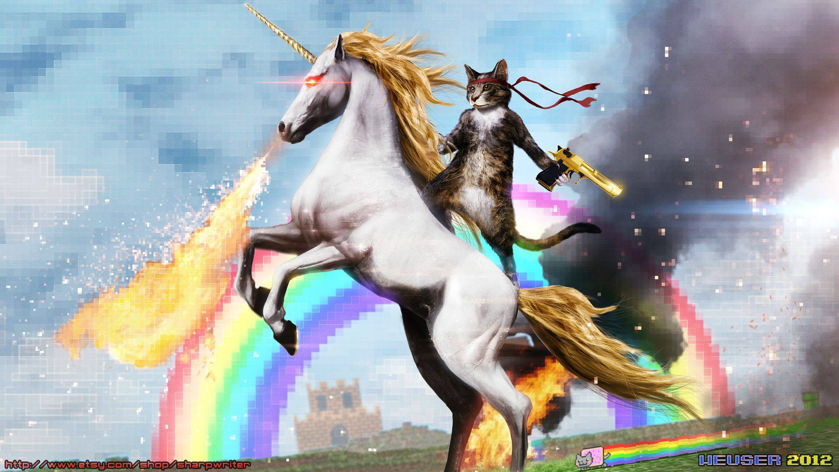
THE INTERNET

Slide 10
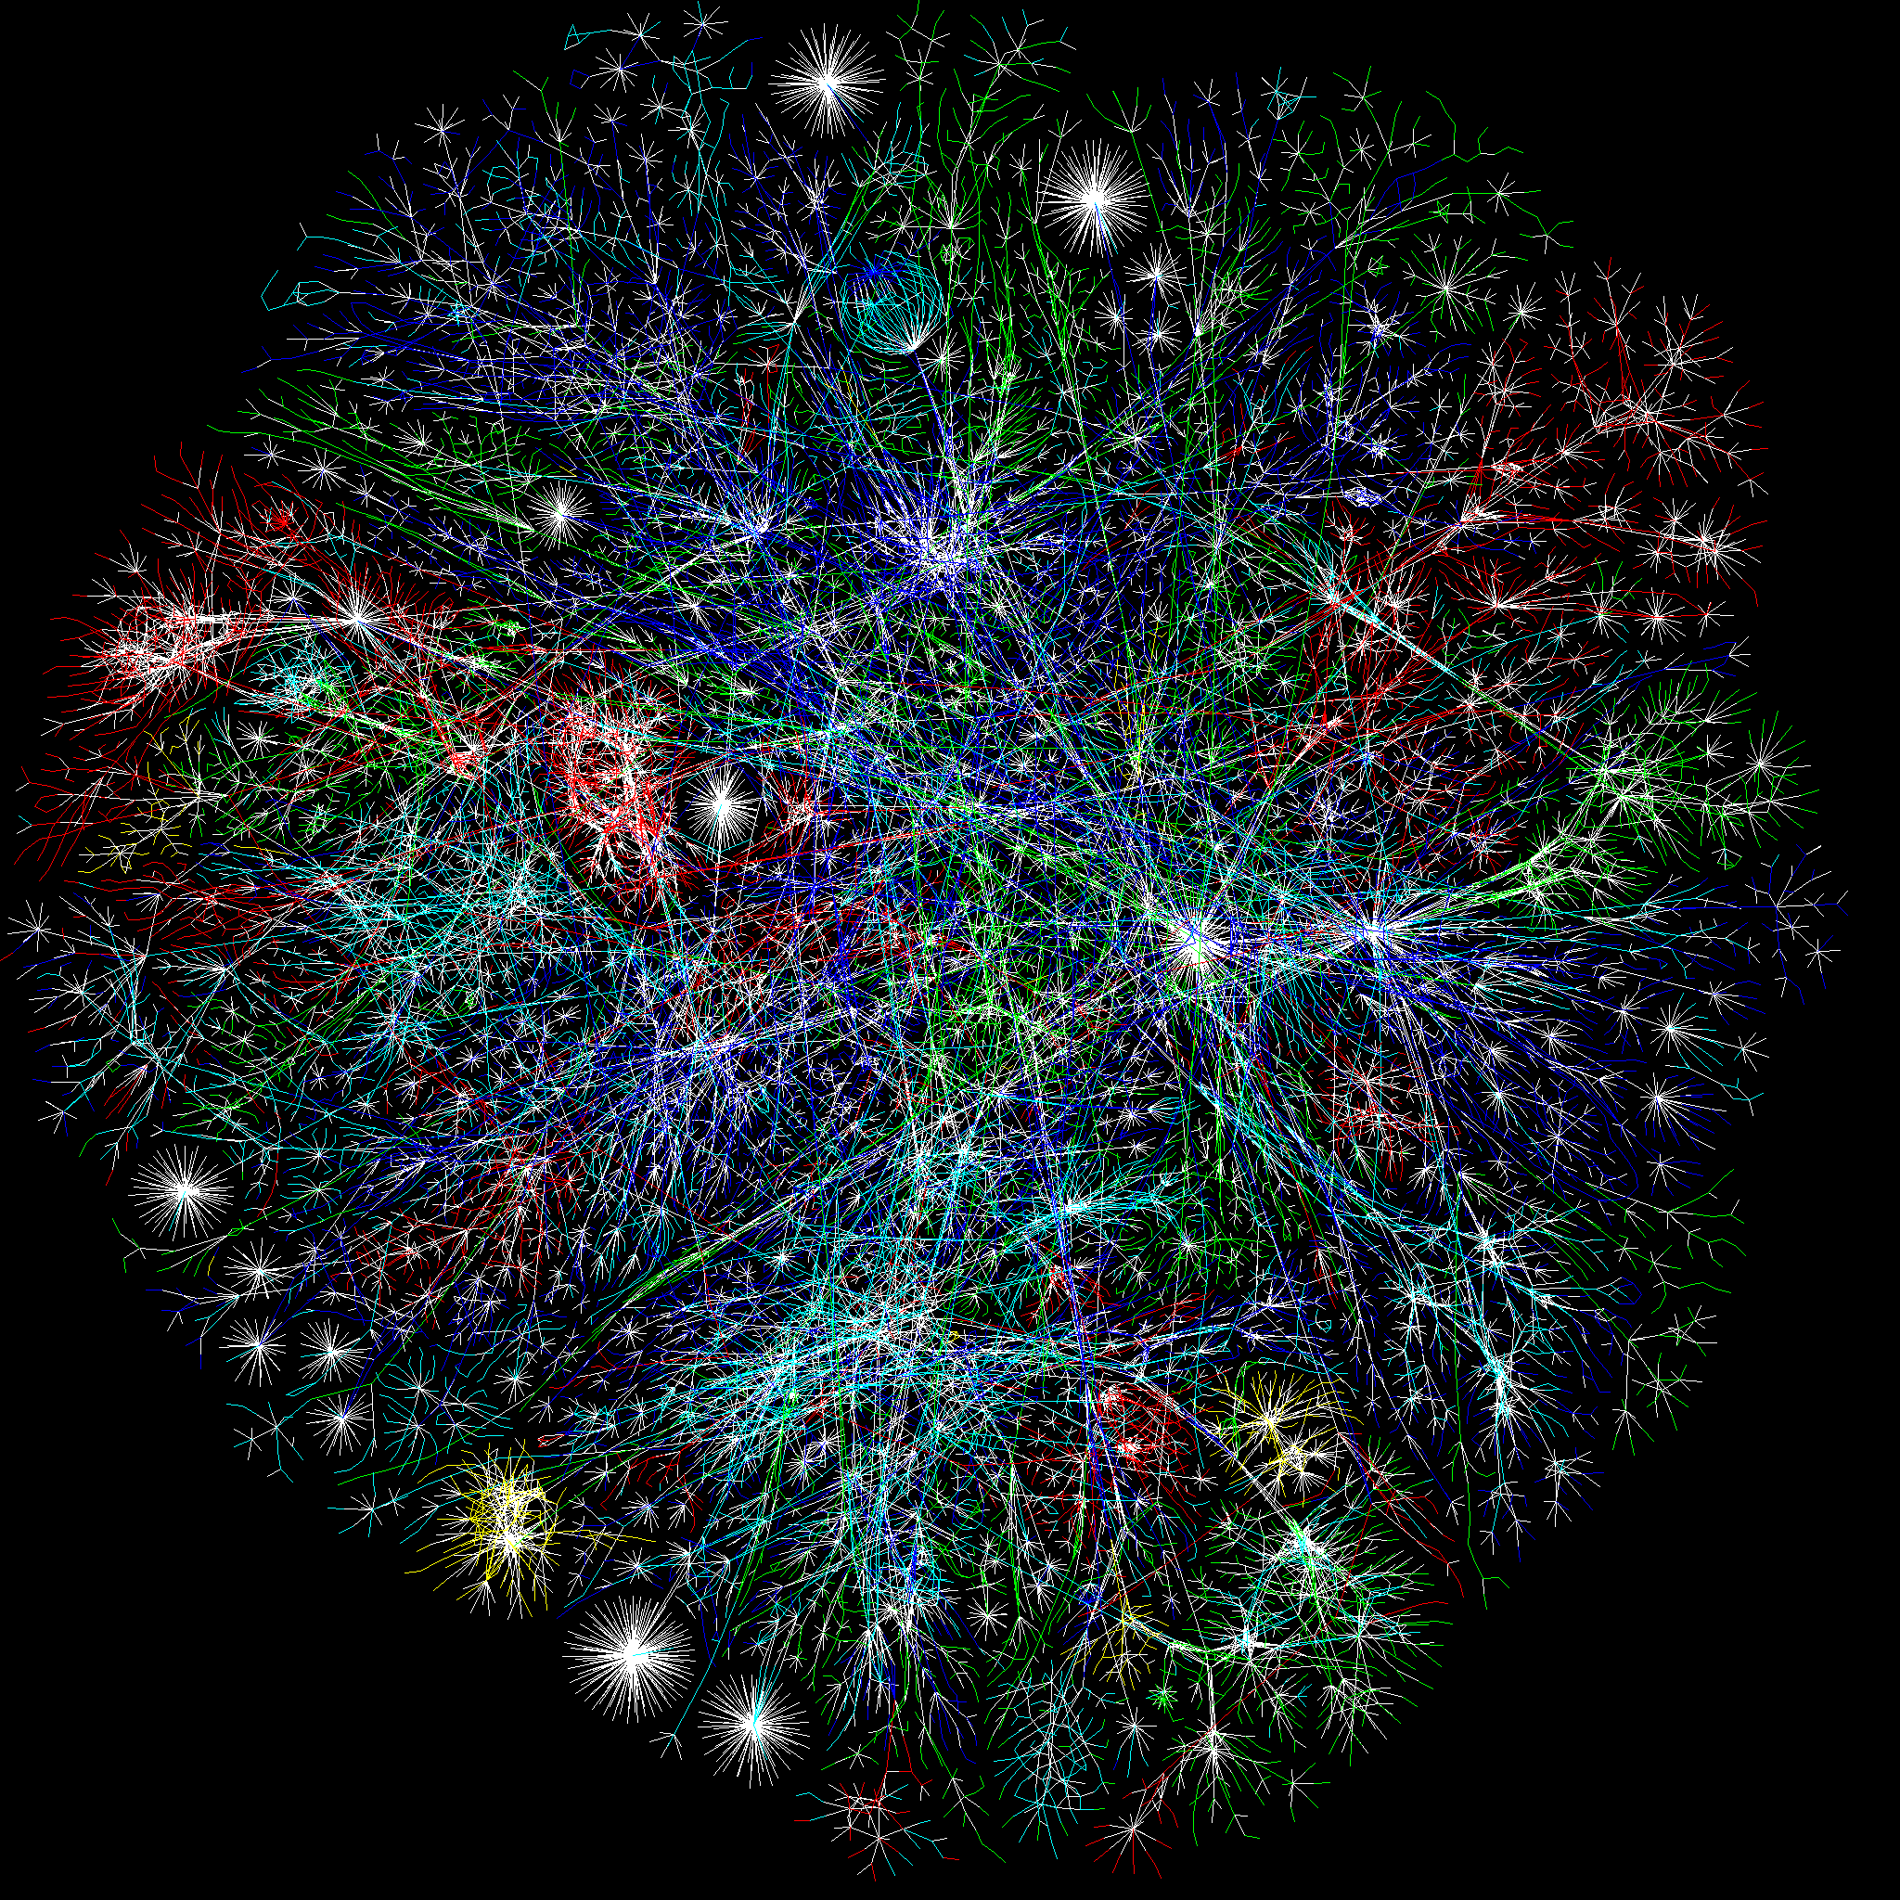
A Collection of Computers
The internet is just a bunch of computers that talk to each other via a bunch of standard languages and protocols. How it came to be is a story involving capitalism, communism, global politics and fear of nuclear holocaust.

Slide 11
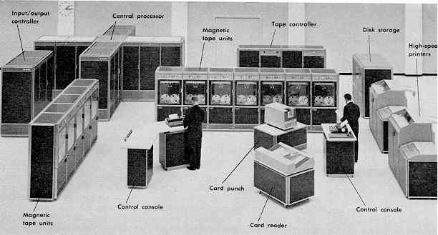
A Story of Evolution
1957 – Invention of timesharing on computers enabling computers to speak to each other.
1958 – DARPA is founded in response to soviet union SPUTNIK launch. In order to spread information they plan a large network of computers

Slide 12
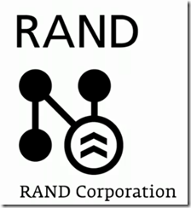


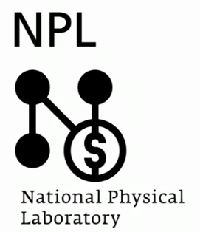
The 60’s - A Lose Collection of Networks

Slide 13
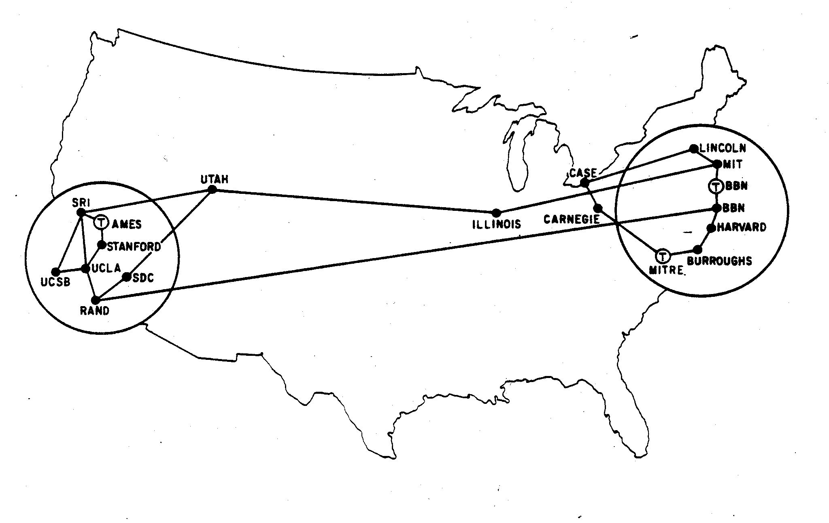
ARPANET
Universities were untrusting to interface mainframes to the ARPANET so they developed smaller, interface computers that proxied requests.
In order for these smaller computers to speak to each other, DARPA developed TCP as the primary protocol for these computers to speak to each other

Slide 14
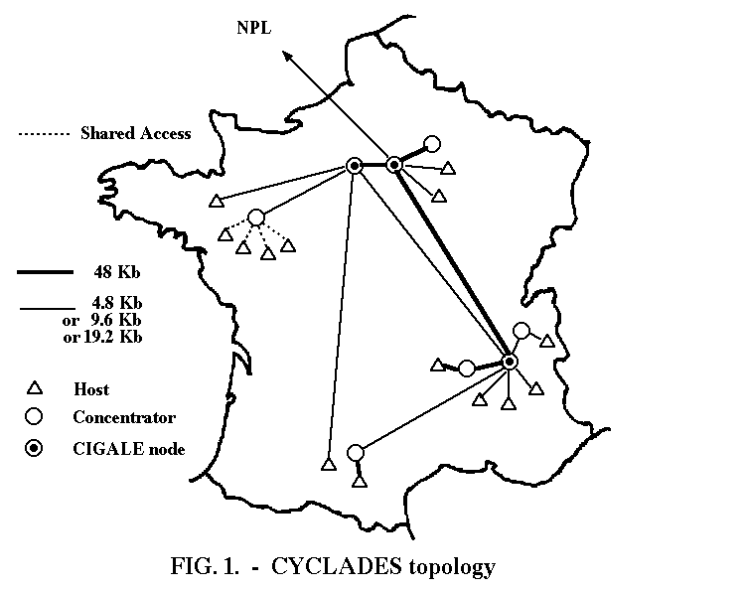
CYCLADES
Having a reduced budget, they were forced to develop a loosely distributed network. In doing this they created hardware level routing, rather then relying on software to route packets.
Thus the router was born.

Slide 15
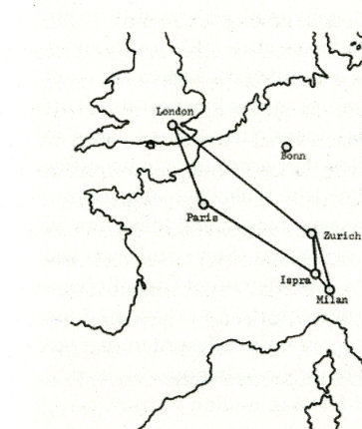
NPL
The other three networks lacked the ability to transfer files. NPL being developed for commerce required file transfer. In order to support sending files, and not ‘breaking the pipes’ the notion of packets were developed to break apart information when sending. Thus packet switching was born.

Slide 16
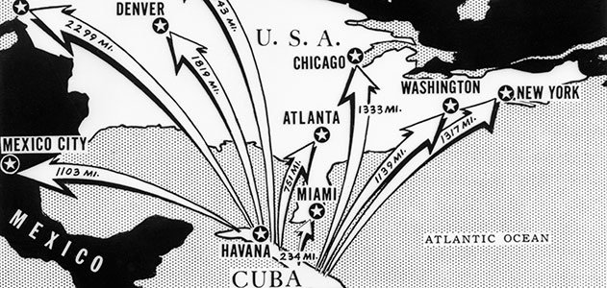
Cuban Missile Crisis
Fear of airborne attack lead to creation of a distributed network, rather than a spoke and hub model network which has single points of failure.

Slide 17

1970’s/80’s - ISO creates a standard
Coming from innovations from TCP, Routing and Packet Switching the International Standards Organization creates an interconnect standard – this becomes the internet.

Slide 18
1990 – The modern internet is born
In 1990 ARPANet is officially retired and the modern internet is born as universities, corporations and research facilities all connect their computers to each other.

Slide 19
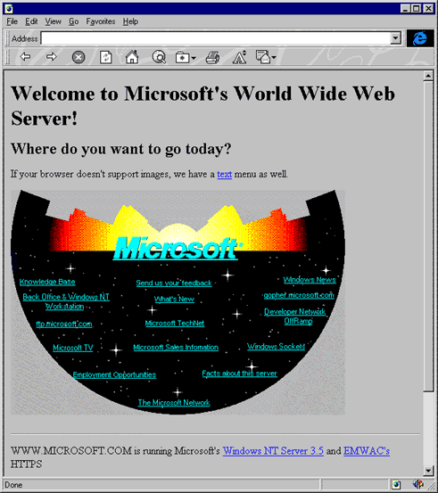
1992- Web 1.0
Initially the WWW was purely text driven, with an image or two providing raw access to content. It was boring and based on HTML, a language developed by Tim Berners.

Slide 20
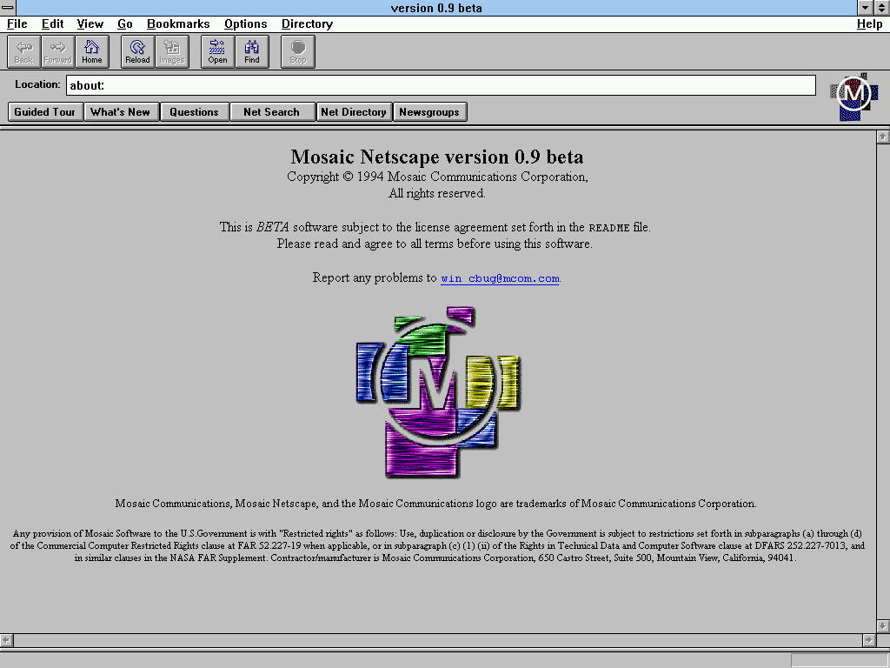
In 1994 W3C was formed
The World Wide Web Consortium was developed and was responsible for crafting future versions of HTML, CSS and JS. In that same Year Netscape was founded, the first true web browser (being built from Tim’s test browser – Mosaic).

Slide 21
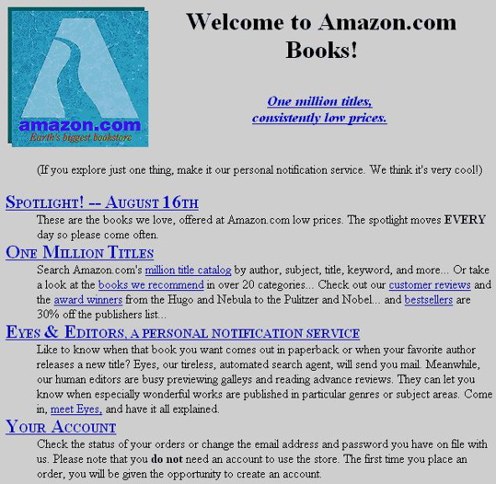
1994 to 2000
From 1994 to 2000 the internet grew by an outstanding rate. Amazon was founded as the first web ecommerce store, and the notion of the modern web was born.

Slide 22
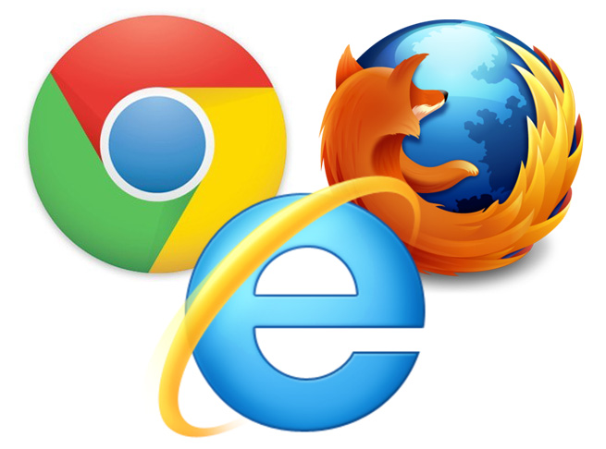
Browser Wars
Until about 2000, there were two main browsers. Netscape and IE, with IE holding 98% of the market.
Starting around 2000 Mozilla was released and the Browser wars began.

Slide 23
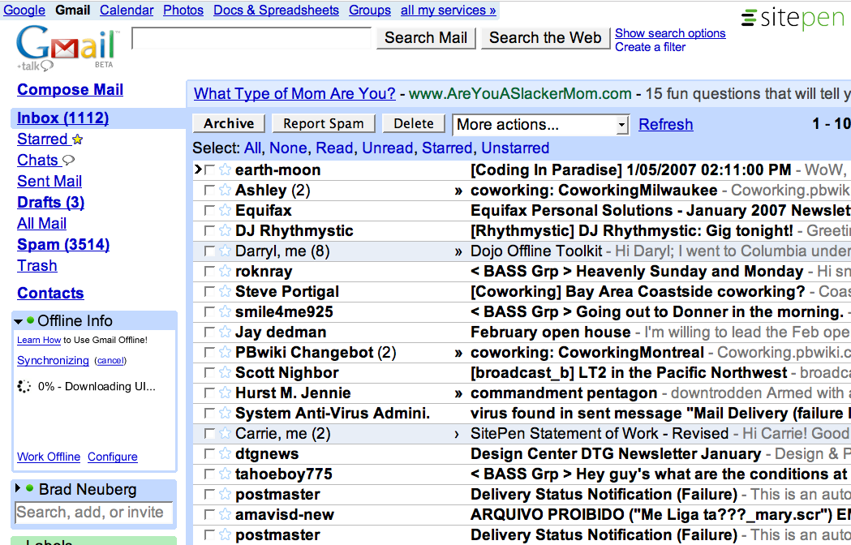
WEB 2.0 (2001- 2004)
In 2000 IE released an update that allowed for async requests to other pages. This action lead to the development of AJAX, a methodology for creating dynamic apps such as Gmail.
Thus Web 2.0 was born.

Slide 24
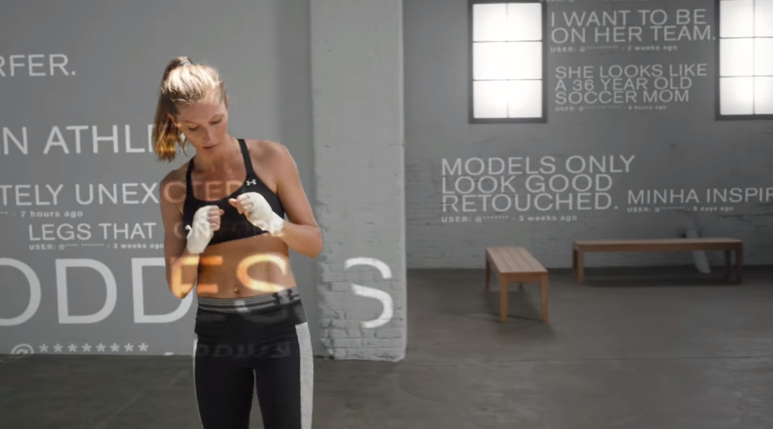
Modern Web
Bat shit crazy.
Over the past 5 years progress has been made to turn the internet into a power house with technologies such as WebGL, HTML5 video / Audio and new server side JavaScript.

Slide 25
OUR FIRST PAGE

Slide 26
BREAK

Slide 27
MAKING IT LOOK BETTER

Slide 28
Assignment
Reading:
HTML & CSS | Chapters 1 through 6.
Development:
Take the simple hello world page that we created today and use that to create a page to link out to the other work you do this semester in this class. Key criteria are:
Should have a header element that titles the page (something like "My Lab Work" - but be creative)
Should have a small section that talks about who you are
Should have a place for links to go that will link out to the work you will be doing
Should be styled with simple colors. Play around - have fun.
And as always, if you have any questions, please feel free to reach out to me.

